Slide 1

V
WIFI-Enabled smart door lock system using
ESP32-CAM for real time access control
Name of the Guide
Guide name: Mr. G Bhaskar Phani Ram
Designation
Assistant Professor
Batch No: A6
Presented By
Ashish Kumar - 21911A0406
Shaik Aslam - 21911A0458
M.Sai Kiran Reddy - 21911A0439
Edla Sruthi - 21911A0426

Slide 2
CONTENTS
ABSTRACT
INTRODUCTION
LITERATURE SURVEY
EXISTING METHODOLOGY
PROPOSED METHODOLOGY( Including Block Diagram)
EXPECTED RESULTS/OUTCOMES
CONCLUSION
REFERNCES

Slide 3
ABSTRACT
This project creates a WiFi-enabled smart door lock system using the ESP32-CAM module integrated with the Telegram app. The ESP32-CAM captures a photo when the doorbell is pressed and sends it to the user via Telegram, allowing them to verify the visitor and control the door lock remotely. Users can lock or unlock the door directly through the app, ensuring secure and convenient access management. Key components include the ESP32-CAM, Relay and a 12V electronic lock. Programmed using the Arduino IDE, this system enhances home security by providing real-time monitoring and control, making it an effective IoT solution for modern smart homes.

Slide 4
INTRODUCTION
This project focuses on designing a WiFi-enabled smart door lock system that uses the ESP32-CAM module in combination with the Telegram app to provide real-time access control for smart homes. When a visitor presses the doorbell, the ESP32-CAM module captures an image and instantly sends it to the user's Telegram account. The user can then verify the visitor's identity and decide to lock or unlock the door remotely, directly from the app. This system is programmed using the Arduino IDE and incorporates key components like a relay, ESP32-CAM. The solution offers enhanced home security by allowing homeowners to monitor their door in real time, even when they are away. By leveraging loT technology, the smart door lock system not only ensures secure access but also provides a convenient, user-friendly way to manage home entry, making it an effective security measure for modern smart homes.

Slide 5
LITERATURE SURVEY
S. No. | Title | Journal Name | Authors | Year of publication | Technology | Key Findings
1 | Door Lock System using HumanFaces wih ESP32-CAM | IEEE | Mahesh chandra,P.pavan Kumar Reddy,M.sandeep | 08-09 December 2023 | ESP32-CAM module | The system integrates facial recognition with PIN access and loT for secure, remote-controlled door operation using the ESP32-CAM.
2 | IoT Operated Door Lock Using ESP32-CAM Module | IJISRT | Indu,suraj kumar Tayal,meenu,sakshi | 8,August 2023 | IoT and ESP32-CAM | The system effectively combines IoT, facial recognition, and motion detection to provide enhanced home security with real-time alerts and user identification.
3 | Low-cost Prototype for IoT –Based Smart Monitoring through Telegram | IEEE | K sivachandar,N G Praveena,C nithiya | 23-25 January 2023 | ESP32,PIR sensor,WI-FI,camera module | The system provides a low-cost, real-time image capture mera module solution using ESP32, PIR sensors, and Wi-Fi for enhanced surveillance

Slide 6
EXISTING METHODOLOGY
The ESP32-CAM is used to control a door lock and take photos and send them to the user via Telegram.
The door can be locked or unlocked remotely from anywhere using commands in the Telegram app.
The ESP32-CAM is programmed using Arduino IDE and integrates with the Telegram app by configuring a bot.
A complex circuit powers the system, using a 12V power supply and components like a transistor,Capacitor,different resistors and voltage regulator to control the lock.

Slide 7
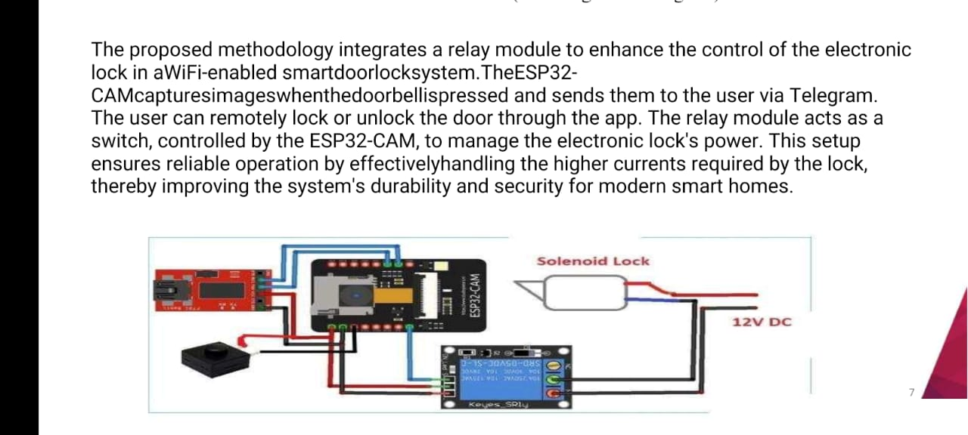
PROPOSED METHODOLOGY
The methodology enhances control of a WiFi-enabled smart door lock system using a relay module.
- The ESP32-CAM captures images and sent to the user via Telegram and Users can remotely lock or unlock the door through an app.
The relay module, controlled by the ESP32-CAM, manages the electronic lock's power.
This setup ensures reliable operation and handles higher currents.
It improves durability and security for modern smart homes.

Slide 8
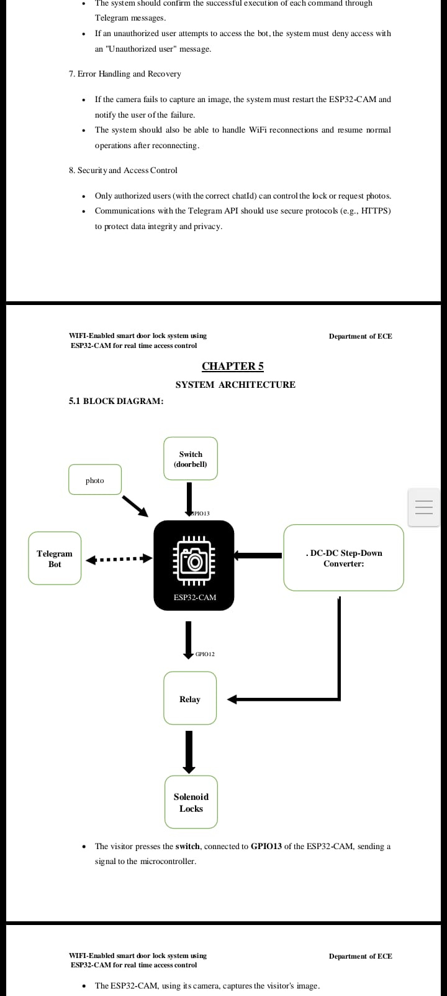
BLOCK DIAGRAM

Slide 9
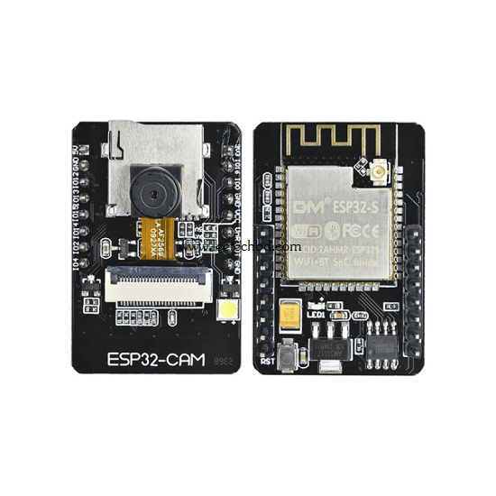
ESP32-CAM:
The ESP32-CAM is a low-cost development board based on the ESP32 microcontroller, equipped with a built-in camera module. It is widely used for applications such as surveillance systems, IoT projects, face recognition, and streaming video. Here's a quick overview of its key features, specifications, and applications:
Key Features:
Microcontroller: ESP32 dual-core processor with built-in Wi-Fi and Bluetooth.
Camera: Typically includes the OV2640 camera module (2MP) but can support others with compatible pinouts.
Storage: Supports microSD cards for data storage (up to 4GB or more).
GPIO Pins: Offers multiple GPIO pins for connecting peripherals, though limited due to the camera module's use.
Programming: Compatible with Arduino IDE, ESP-IDF, and other platforms.
Compact Size: Extremely small and versatile form factor.

Slide 10
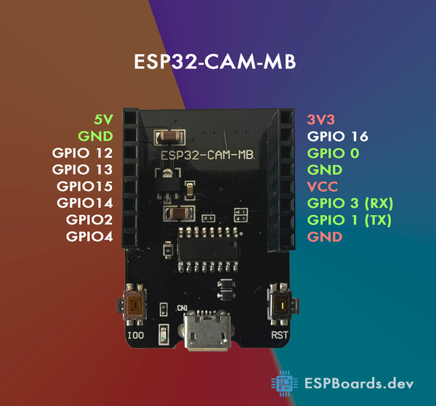
ESP32 CAM Programming Module:
The ESP32-CAM Programming Module is an interface specifically designed to make it easier to program the ESP32-CAM development board. It eliminates the need for a separate USB-to-Serial adapter and helps in seamless programming of the ESP32-CAM.
Key Features of ESP32-CAM Programming Module:
Built-in USB-to-Serial Adapter:
Integrates a CP2102 or CH340 USB-to-Serial converter for easy programming.
No need to wire up a separate FTDI adapter.
Plug-and-Play Functionality:
Provides a micro-USB interface for powering and programming the ESP32-CAM.
Programming Mode Button:
Automatically or manually sets GPIO0 low to put the ESP32-CAM into bootloader mode.

Slide 11
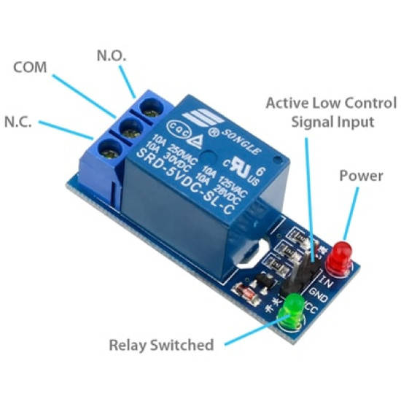
RELAY:
A relay is an electrical device used to control a circuit by opening or closing contacts in response to a signal, typically from a low-power source. It consists of an electromagnet, a movable armature, and a set of contacts. When current flows through the coil of the relay, it generates a magnetic field that moves the armature, either opening or closing the contacts to control the flow of current in a different circuit.
Components of a Relay:
Electromagnet: Generates a magnetic field when current flows through it.
Armature: A movable component that opens or closes the switch.
Spring: Holds the armature in place when the relay is inactive.
Contacts: Electrical connections that open or close circuits.
Coil: The winding that generates the magnetic field in the electromagnet.

Slide 12
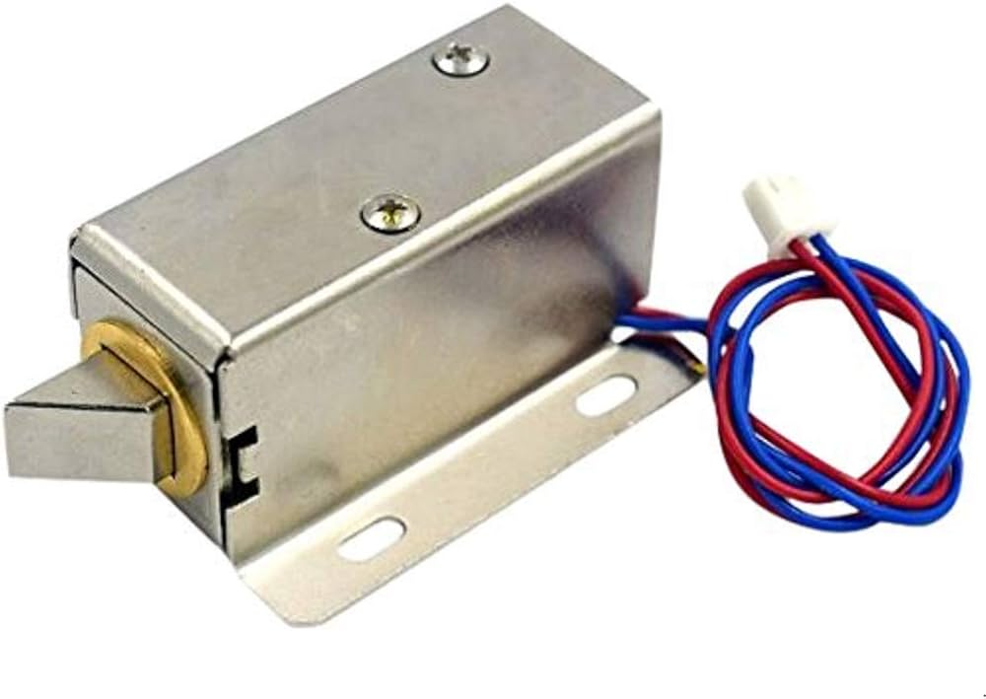
SOLENOID LOCK:
A solenoid lock is an electromechanical locking mechanism commonly used in access control systems. It operates by using a solenoid to control the locking and unlocking action.
Key Features:
High Security:
Often used with access control systems like keycards, keypads, or biometric scanners.
Durability:
Designed for repeated use and various environmental conditions.
Energy Efficiency:
Only consumes power during operation, depending on the design.
Compact Size:
Suitable for doors, lockers, safes, or vending machines.
Easy Integration:
Compatible with microcontroller systems for automation.

Slide 13
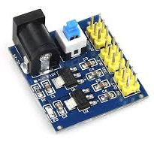
DC-DC Step-Down Converter:
A DC-DC Step-Down Converter, also known as a Buck Converter, is an electronic device that converts a higher DC voltage to a lower DC voltage efficiently. It is widely used in power supply systems to regulate and step down voltage for various components.
Key Features
Voltage Reduction: Converts high input voltage (e.g., 12V) to a lower output voltage (e.g., 5V or 3.3V).
High Efficiency: Typically operates at efficiencies of 85% or higher, minimizing heat dissipation.
Compact Size: Compact and lightweight compared to linear voltage regulators, making them ideal for portable applications.
Adjustable Output: Some models allow the output voltage to be adjusted using potentiometers or external resistors.
Protection Features: Many converters include overcurrent, overvoltage, and thermal protection.

Slide 14
EXPECTED RESULTS/OUTCOMES
The smart door lock system will allow homeowners to receive real-time images of visitors via Telegram when the doorbell is pressed. Users can then remotely control the door lock by sending commands through the Telegram app, ensuring secure and convenient access management from anywhere. The system is designed to operate reliably, with the ESP32-CAM capturing and transmitting images and the relay module accurately locking or unlocking the door based on user commands.

Slide 15
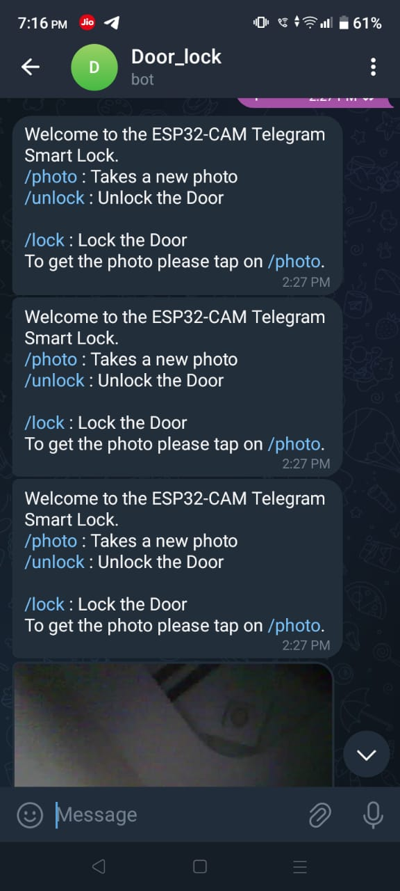
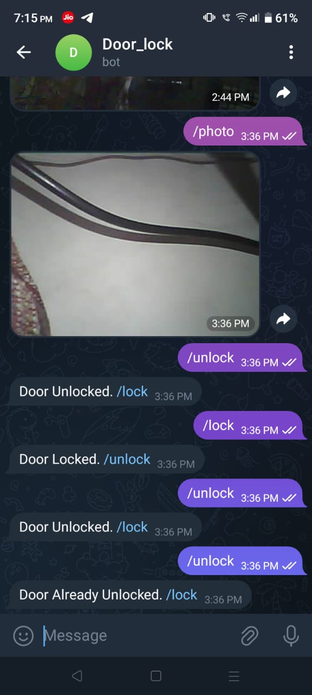

Slide 16
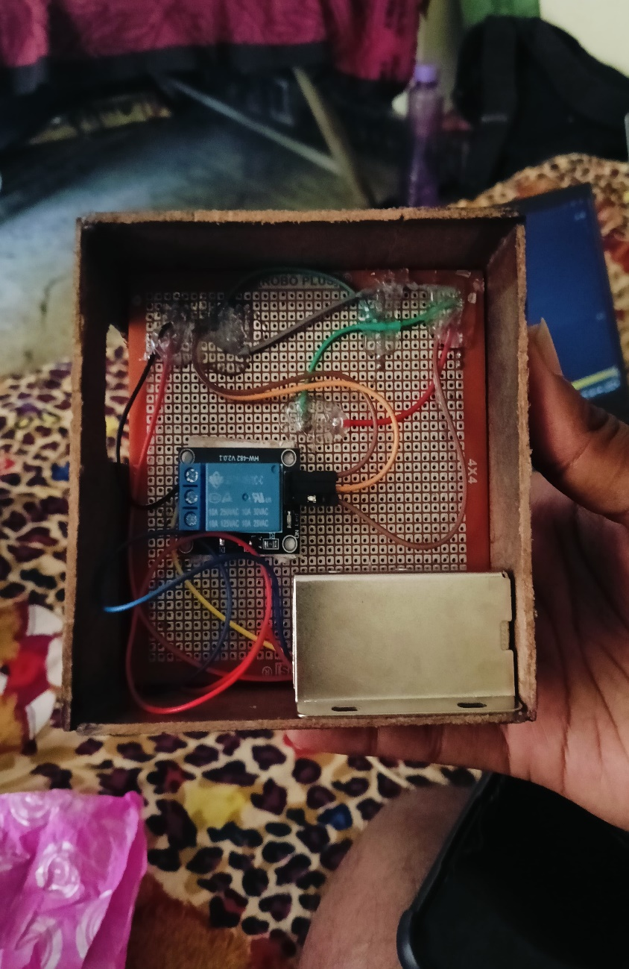
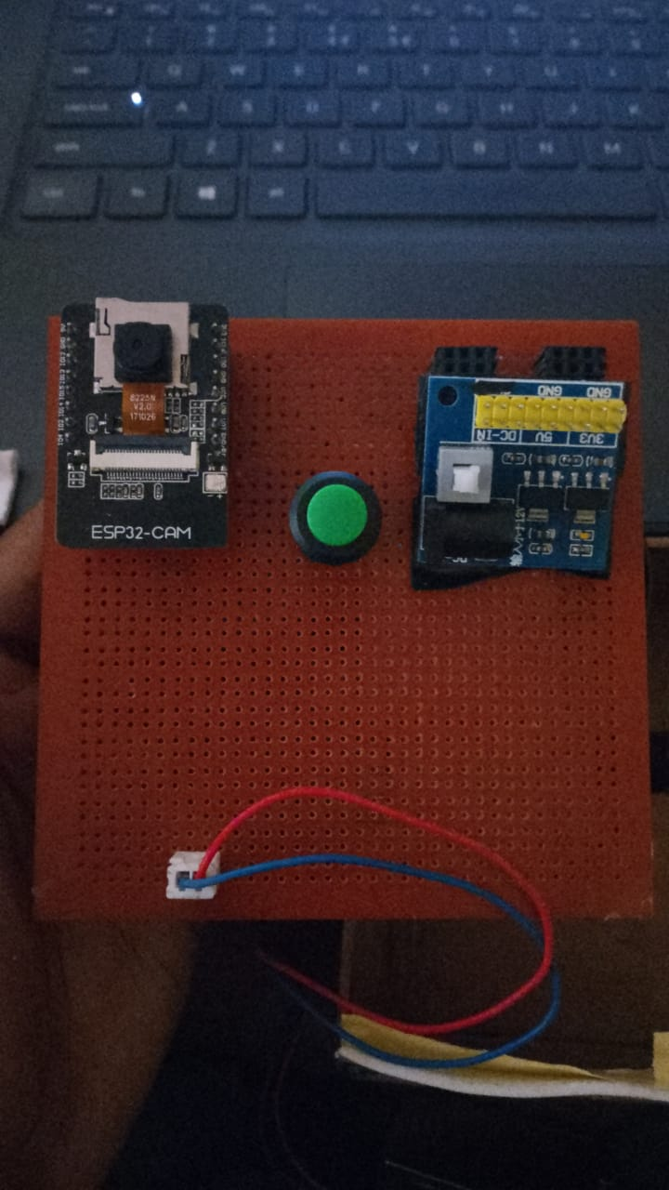
CONCLUSION
"Hence, by using this advanced technology, we can ensure the safety of our house by sending and receiving messages and photos through the Telegram application. Additionally, we can open the door without touching the lock. This helps us save time."

Slide 17
REFERENCES
Mahesh Chandra, M. Sandeep, P. Pavan Kumar, "Door Lock System Using HumanFaces With ESP32- CAM, "Fourth International Conference on Smart Technologies in Computing, Electrical and Electronics (ICSTCEE), 10.1109/ICSTCEE60504.2023.10584952.
ndu, suraj kumar tayal, meenu, "IoT Operated Door Lock using ESP32 CAM Module ",2023 International Conference on Cognitive Robotics and Intelligent Systems (ICC-ROBINS).
K Sivachandar, N G Praveena, C Nithiya, "Low-cost Prototype for IoT-based Smart Monitoring through Telegram," 2023 5th International Conference on Smart Systems and Inventive Technology (ICSSIT), 10.1109/ICSSIT55814.2023.10061,155

Slide 18
Thank you

